Slide 1
CS Task 2: SE Process
Project pink

Slide 2
Plan driven vs agile
for the mhc-pms system

Slide 3
Key facts
Legal restriction
Data security
Project Character
changing health system
unclear requirements

Slide 4
Software Engineering
Done by Team pink

Slide 5
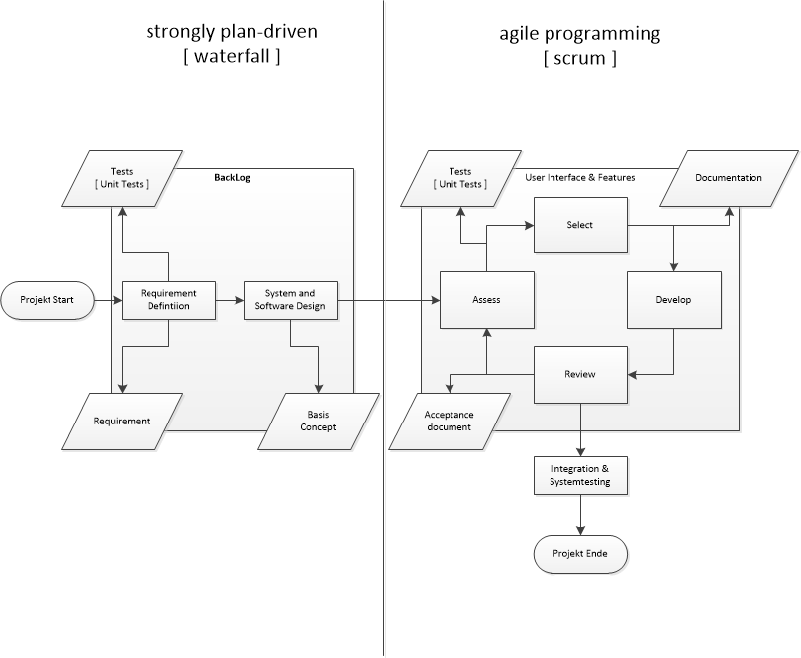
Process

